Slide 1
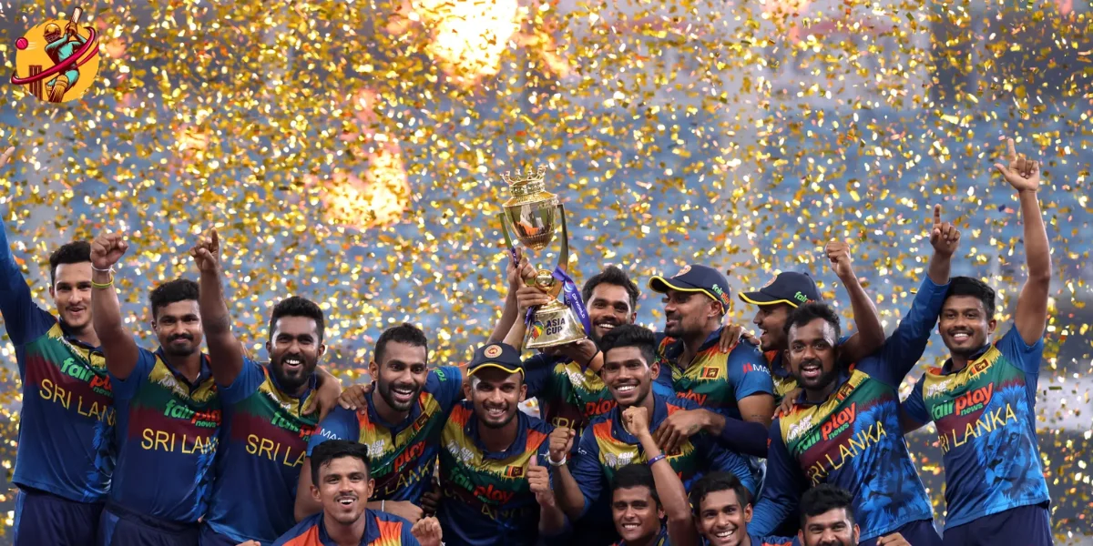

T20 CRICKET GAME SIMULATION
GROUP MEMBERS:
EG/2021/4680: MUNASINGHE B.P.R.D.
EG/2021/4684: MUNSIF M.F.A.
EG/2021/4691: NILUMINDA G.W.N.
EG/2021/4693: NIRMANI G.A.K.S.
GROUP NO- 10
ADVISED AND SUPERVISED BY:
MR. THARINDU DHARAMASENA

Slide 2
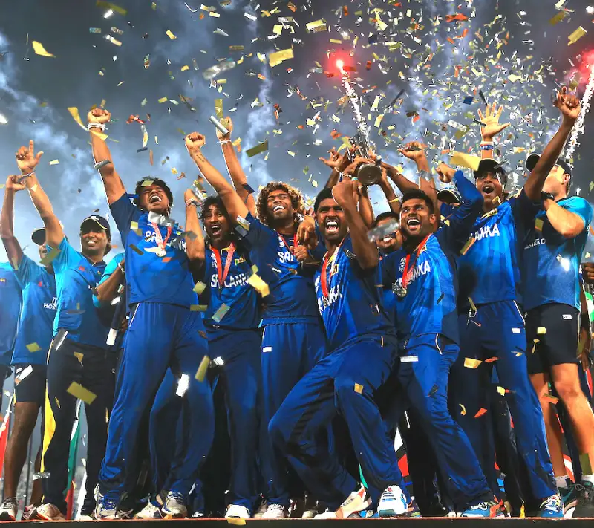

INTRODUCTION
T20 cricket is a popular sport due to its fast-paced and exciting nature.
The project aims to simulate a T20 cricket match using Verilog.
Key aspects of the simulation include player actions, scoring, and match progression.
Random values (1-15) will be generated to simulate outcomes like runs, wickets, sixes, and no balls.
Shift register (LFSR), comparator, adders and counters used to create a functional simulation of T20 cricket

Slide 3


METHODOLOGY
1. LFSR Module
•Generate random 4-bit numbers with a Linear Feedback Shift Register.
•Simulate scores and wickets.
2. Score Management Module
•Track and update scores and wickets.
•Handle game states (innings over, game over)
3. Score Comparator Module
•Compare final scores to determine the winner.
4. LED Controller Module
•Manage LED display for ball count and game status.
•Indicate game states with LEDs.

Slide 4
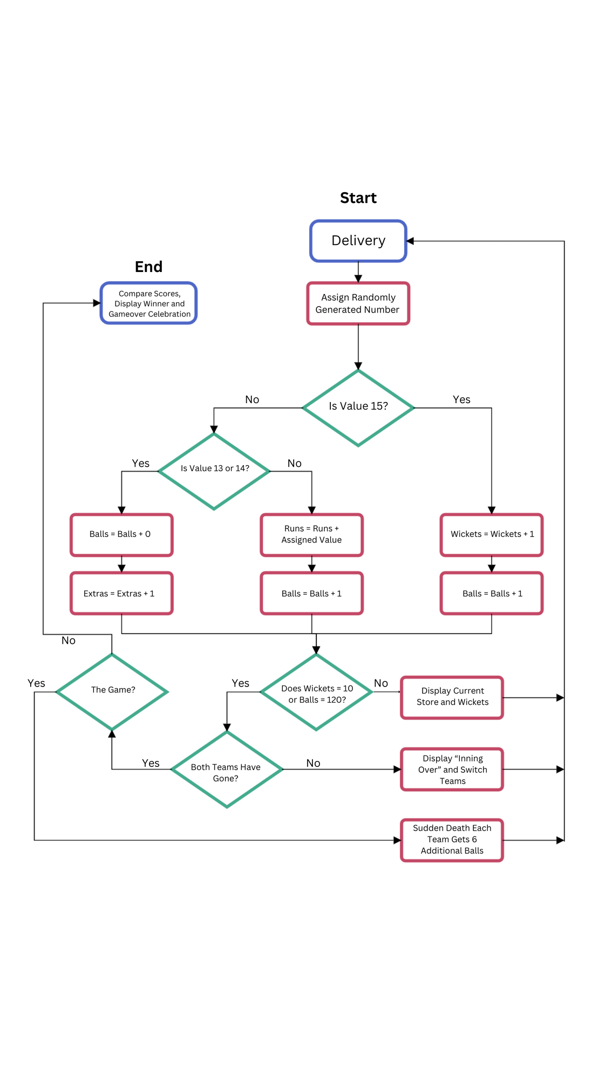
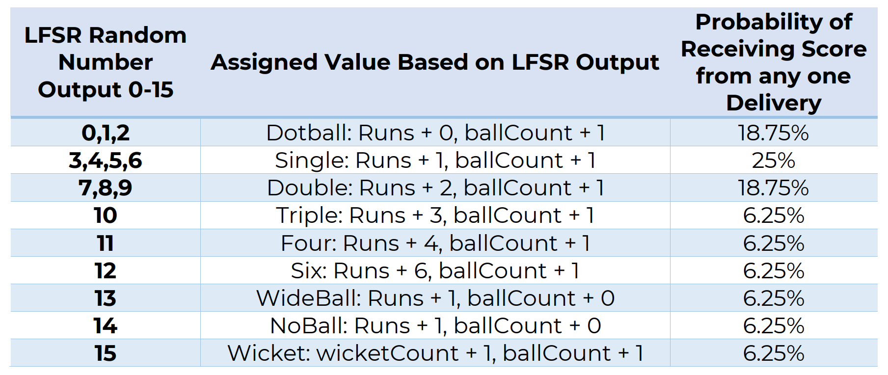
Work Flow
The pseudorandom number sequence generated by LFRS is used to assign the score and wickets for each delivery of a ball. The scores for Twenty 20 cricket tend to rarely exceed 256. Teams also usually end their innings because they reached 120 balls, rather than by losing 10 wickets. Random number is carefully generated in order to achieve realistic scores

Slide 5

OBJECTIVES
Design a digital T20 cricket simulation using Verilog.
Implement the system on an FPGA.
Demonstrate functionality and performance through test cases

Slide 6
CONCLUSION
The project will provide a comprehensive and interactive T20 cricket simulation using Verilog.
Enhance understanding of digital design and Verilog programming.
Gain practical experience in FPGA implementation.
Create a functional and engaging cricket game simulation showcasing hardware description languages and FPGA technology.

Slide 7
THANK
YOU

